Slide 1

Basic User Interface in Xamarin.Forms

Slide 2

Ralph Gutierrez, Senior Mobile App Developer
BCS Technology International - Philippines

Slide 3
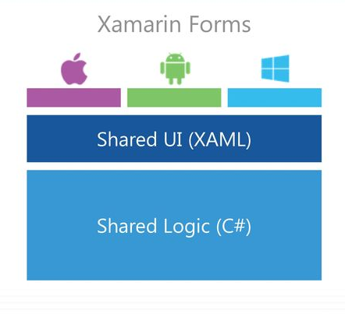
What is Xamarin Forms
Xamarin.Forms allows developers to create
user interfaces in XAML with code-behind in
C#. These interfaces are rendered as
performant native controls on each platform.

Slide 4
Who Xamarin.Forms is for ?
Xamarin.Forms is for developers with the following goals:
Share UI layout and design across platforms.
Share code, test and business logic across platforms.
Write cross-platform apps in C# with Visual Studio.

Slide 5
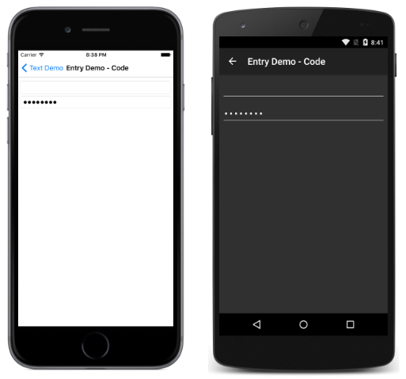

Using Input

Slide 6
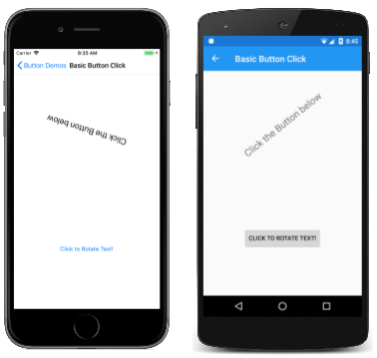
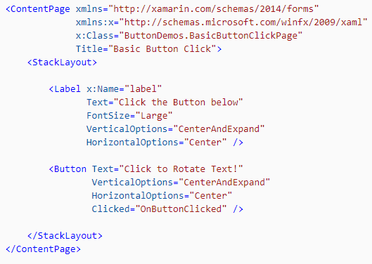
Using Button

Slide 7
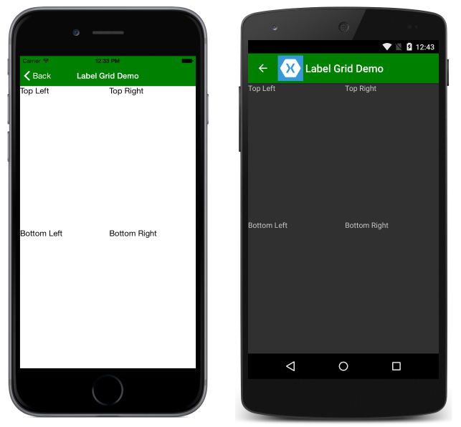
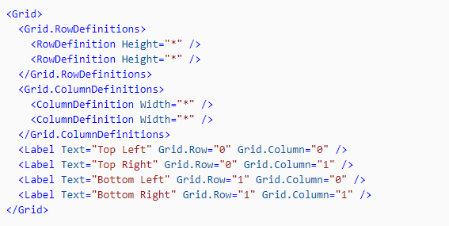
Using Grid

Slide 8
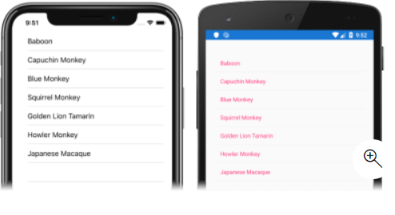
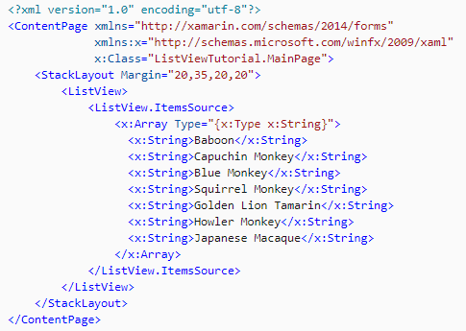
Using Listview

Slide 9
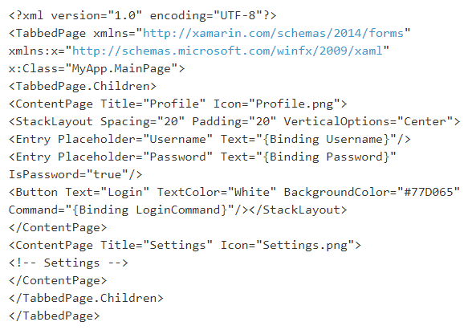
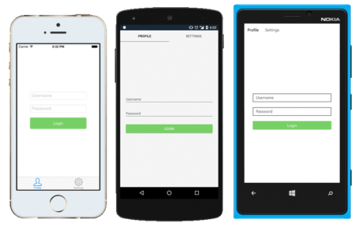
Using XAML

Slide 10
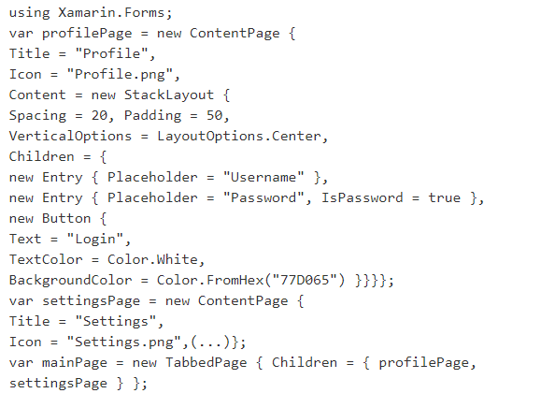
Using C#

Slide 11
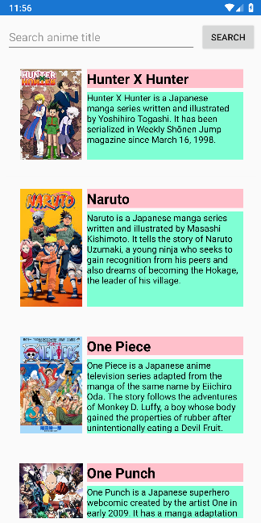
<Entry/>
<Button/>
<Listview/>

Slide 12
Thank you!
Shoot your Questions!
Ralph Gutierrez, Senior Mobile App Developer
BCS Technology International - Philippines

